Slide 1
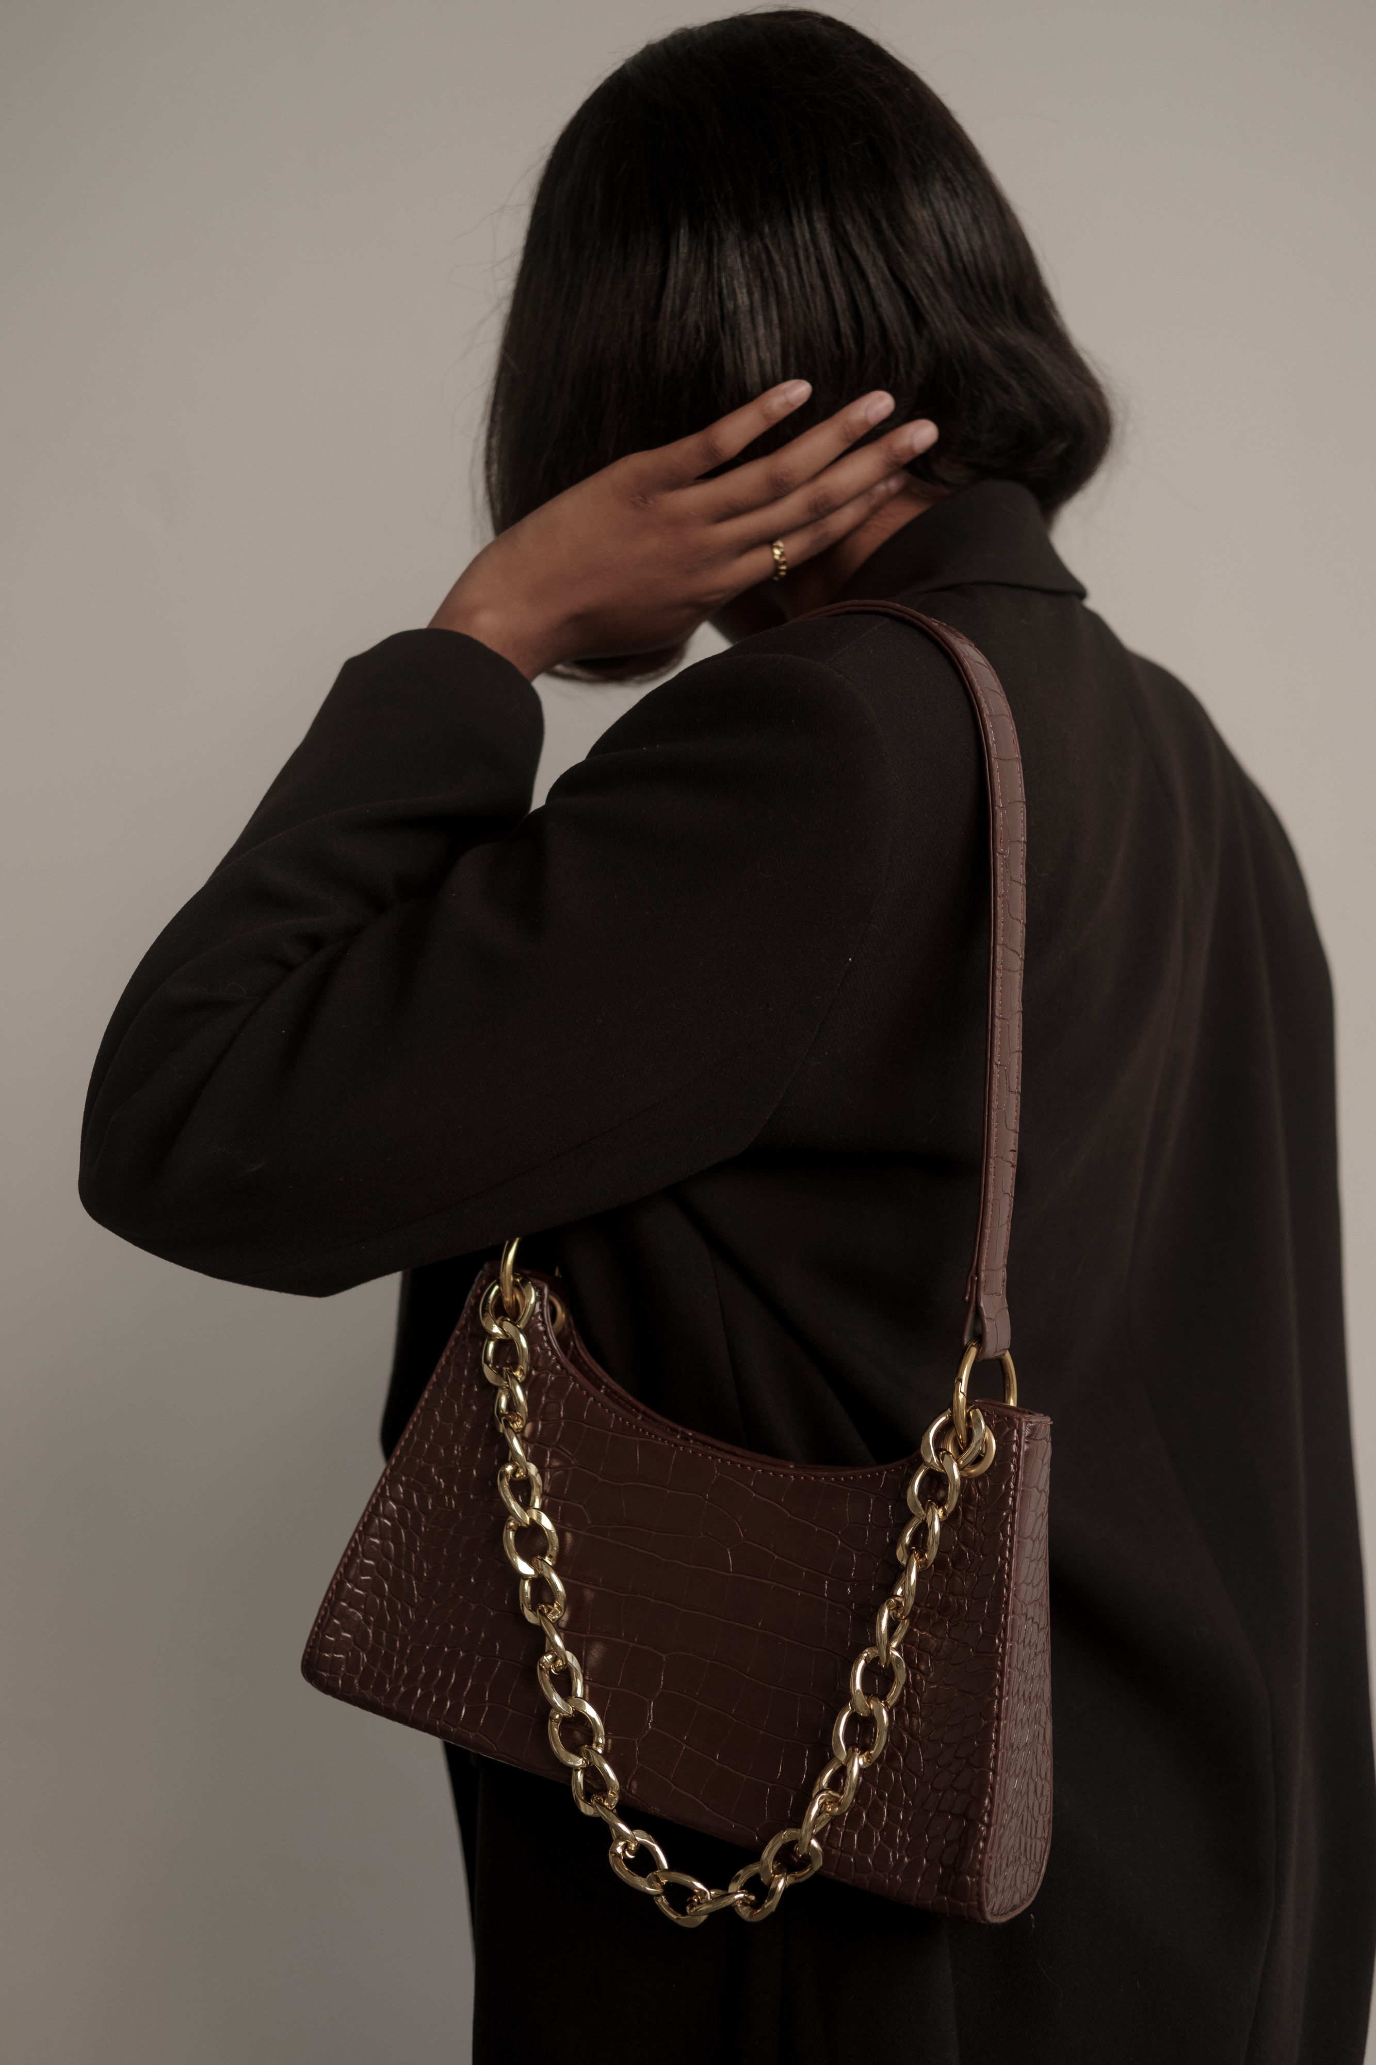
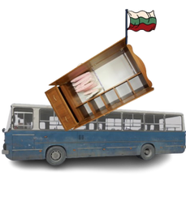
GARDEROBUS
THE BULGARIAN WARDROBE ON WEELS

Slide 2
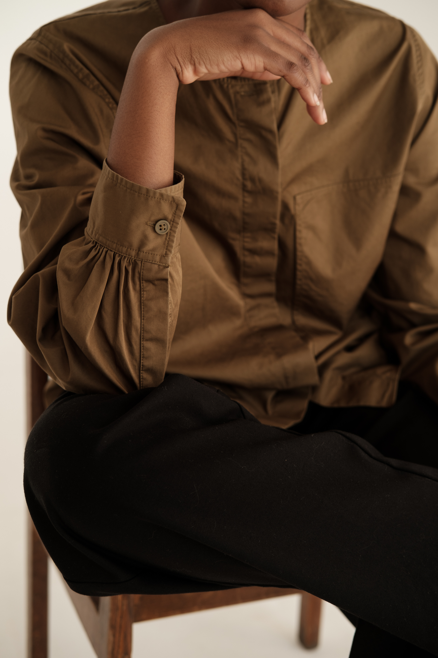
СЪДЪРЖАНИЕ
Classes
Start frame and functions
Add item frame and functions
View your gallery
SOON TO COME
Generate an outfit
View saved outfits

Slide 3

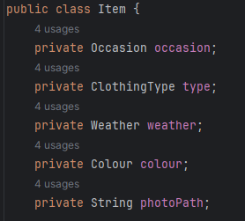
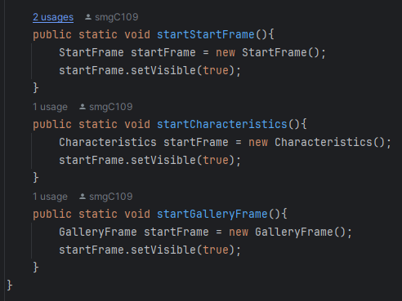
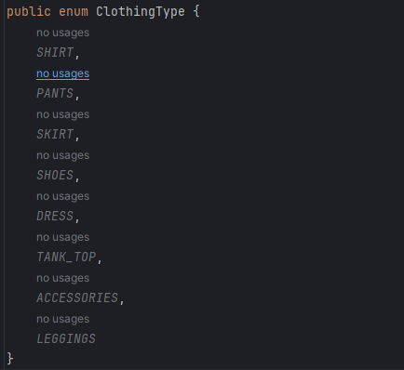
Main
Item
ImageFilter
GradientBth
StartFrame
GalleryFrame
Characteristics
Clothing Type
Colour
Occasion
Weather
ОСНОВНИ
КЛАСОВЕ
FRAMES
ENUMS

Slide 4
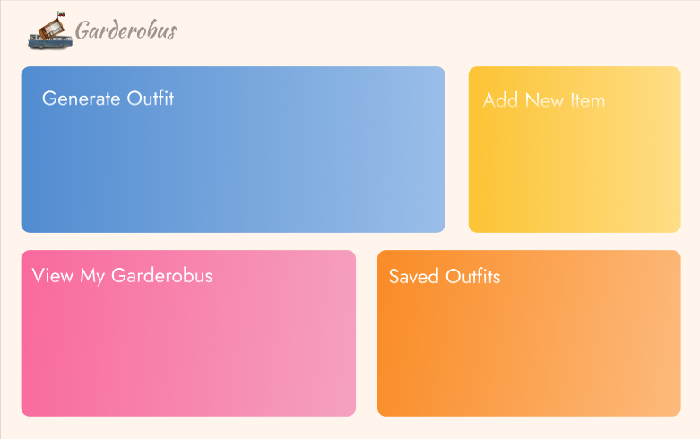

START
FRAME

Slide 5
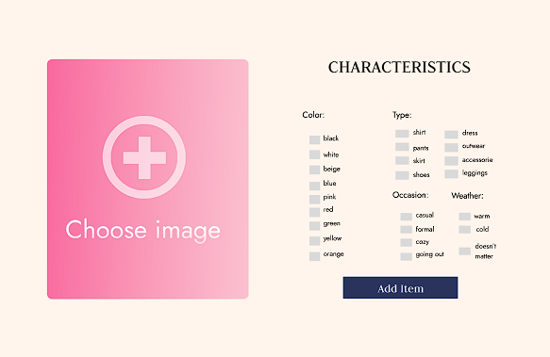
ADDING NEW
ITEM

Slide 6
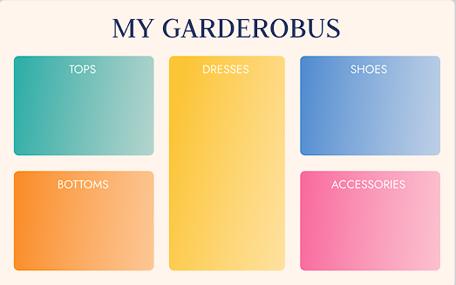
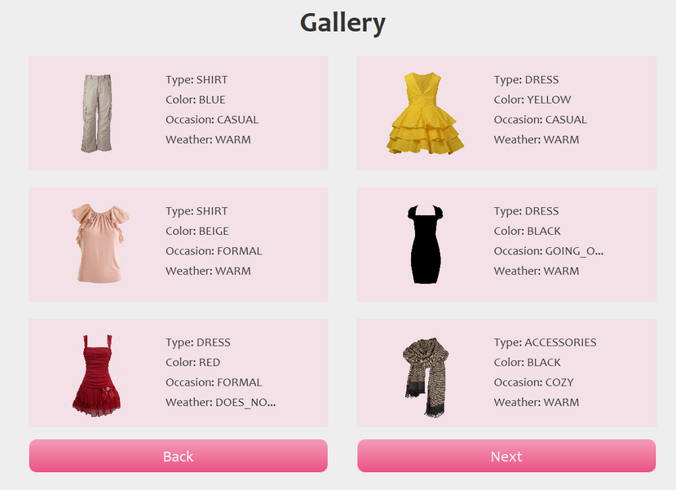

GALLERY FRAME

Slide 7

В БЪДЕЩЕ

Slide 8
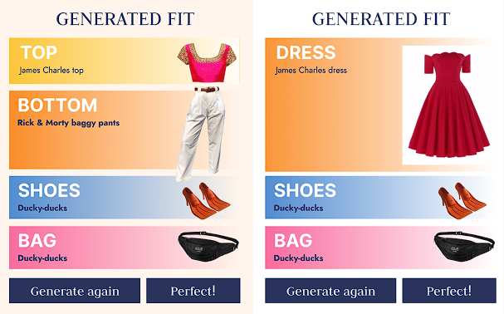
GENERATE OUTFIT

Slide 9
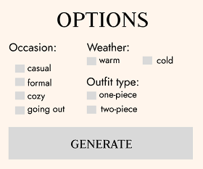
GENERATE OUTFIT

Slide 10
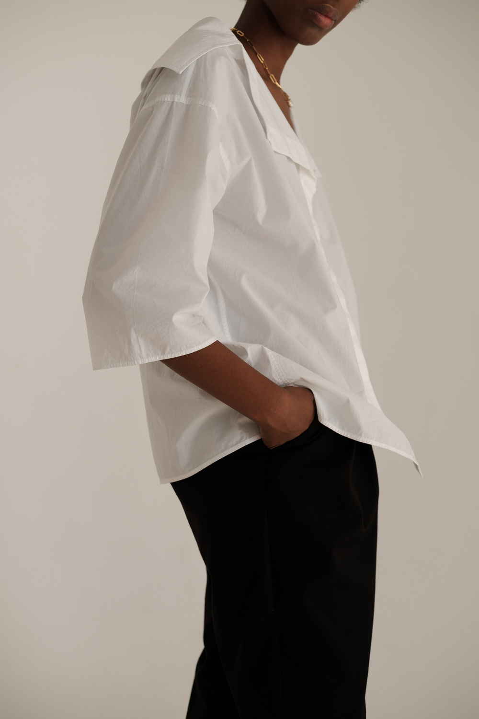
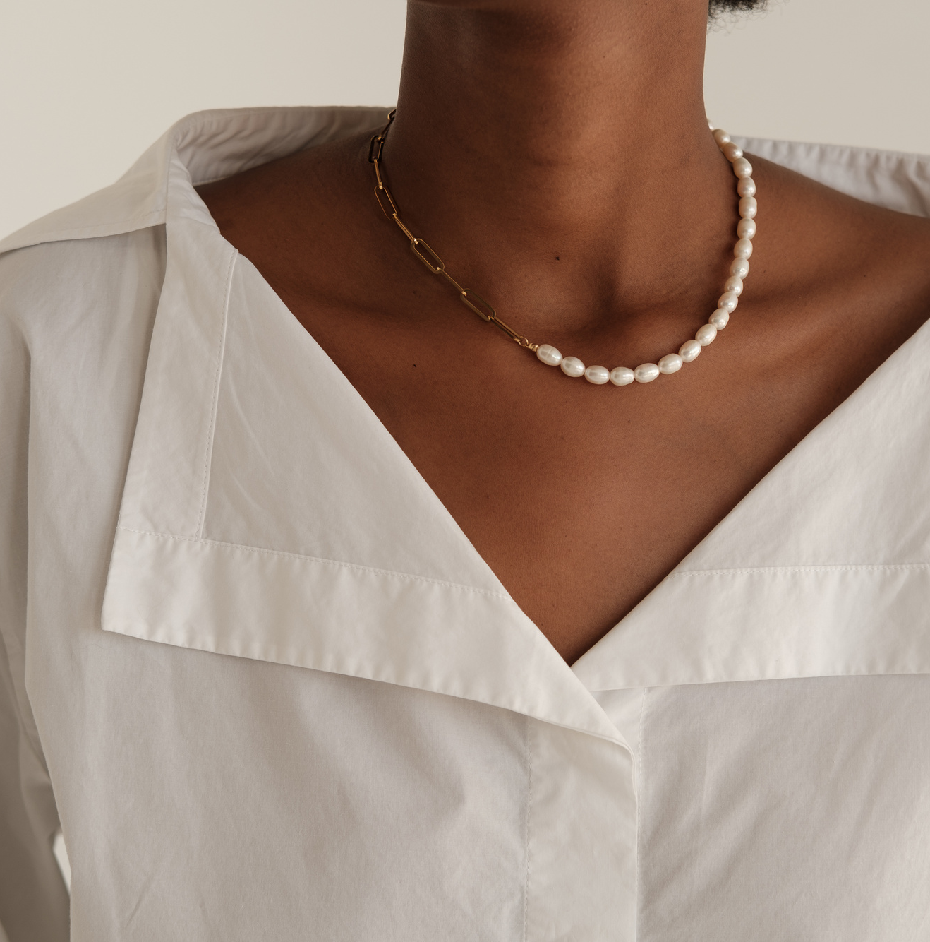
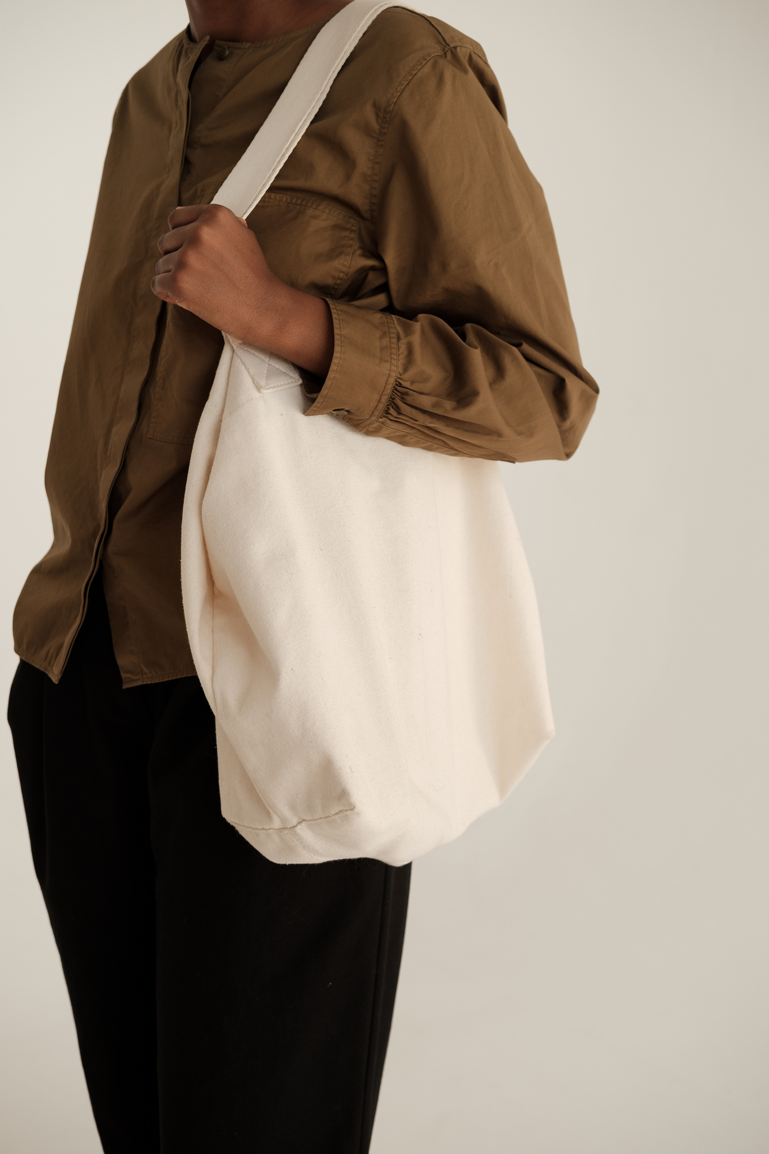
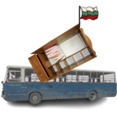
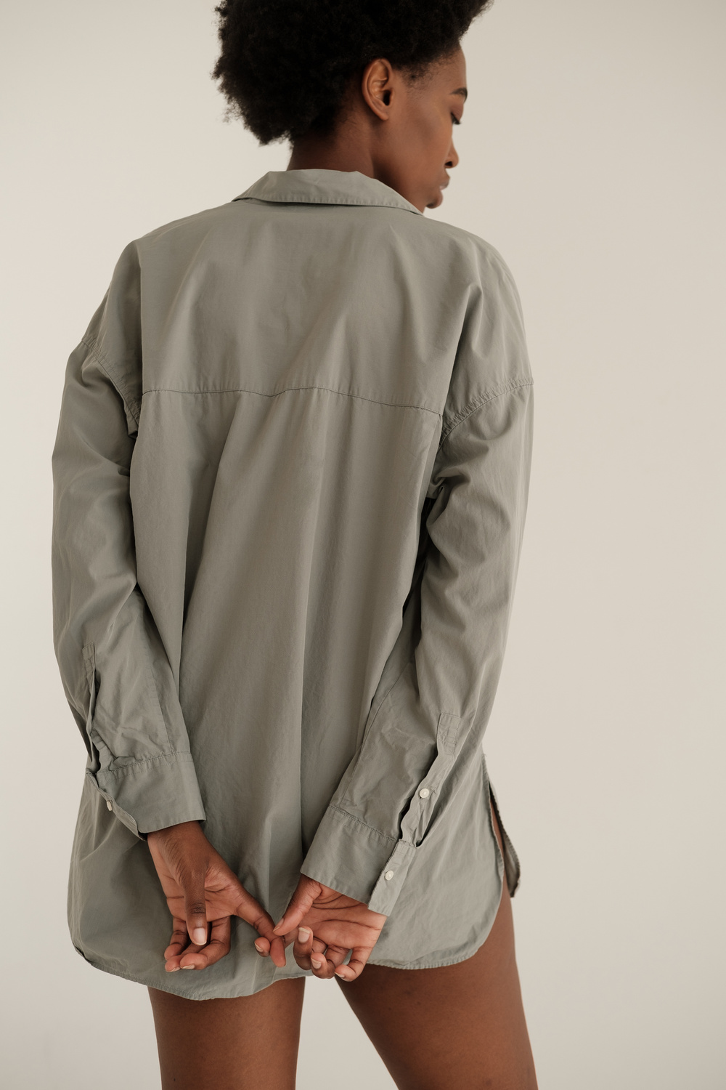
БЛАГОДАРИМ ЗА ВНИМАНИЕТО
GARDEROBUS

